Slide 1
ENHANCED MEDICAL DATA SECURITY FRAMEWORK
Team Details
B. Mounika(20EG105404)
K. Surya Teja(20EG105418)
P. Manvitha(20EG105434)
Project Supervisor
Dr.K.Madhuri
Associate Professor

Slide 2
Introduction
Medical data stands out as a highly confidential and crucial subset, encompassing a patient's health records, medical history, diagnosis, and prescriptions. The sensitivity of this data necessitates stringent privacy measures, restricting access solely to the patient and their designated healthcare provider. The rising importance of preserving the confidentiality of medical data has led to the development of many strategies. These strategies include secure storage, encryption, access control policies, and regulated data sharing, ensuring that only authorized individuals can access and interact with the information.
This approach concentrates on the three security parameters, confidentiality, authentication and integrity. These parameters are the basic units to establish any security framework. Considering them, the framework has been designed. It also encompasses a secure infrastructure of the storage of patient information to ensure everything is only visible to the authorized. It employs encryption protocols to safeguard the information when it is transmitted. Access control policies are implemented to regulate user access.
Confidentiality will be emphasized when the data is being shared by using encryption algorithms, which make sure the data is only known to the sender and the correct receiver. Encryption and decryption will allow the privacy of data during transit. All these functionalities together build an interface for secure communication and seamless interactions.

Slide 3
Problem Statement
Sensitive data is associated with medicine cannot be publicly displayed. Rather than using image files and audio files, which would make it a bit hard to understand, encryption can be done with text files as they would be more descriptive and clear. Along with encryption, access control policy can be introduced simultaneously providing an interface for patient and doctor to communicate. In the current need to secure medical data that should only be accessed by authorized individuals or an organization, this approach will concentrate on establishing data security and communication.

Slide 4
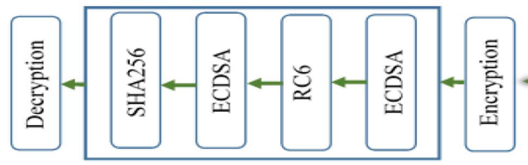
Problem Illustration
The system is associated with providing security to image and audio files from implantable devices in the human body via the internet. Algorithms like RC6, ECDSA, and SHA-256 are combined as a hybrid algorithm. RC6 algorithm is used for generating a key value, and EDCSA encrypts the first generated key value then the encrypted key value is sent to a secure hash algorithm.
The whole process of using three algorithms for encryption and decryption is complex and time-consuming. So, we can find a better algorithm to replace them.

Slide 5
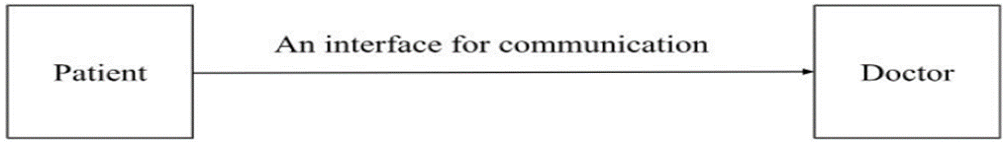
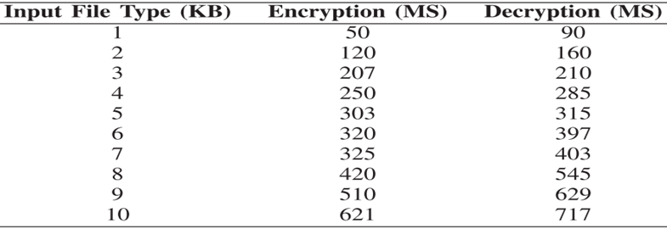
The major limitation of the provided system is there is no interface or framework to connect the sender and receiver of the files. An interface will be established as an improvement.
The time analysis is provided for encryption and decryption when the RC6 algorithm is used.
The chosen algorithm must take less time to encrypt and decrypt.

Slide 6
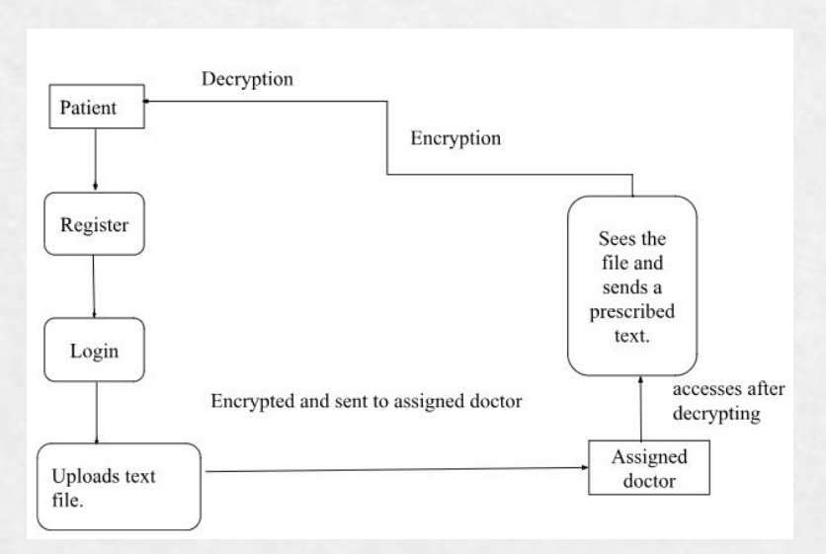
Proposed Method
Attribute-based encryption technique is proposed where patient data is encrypted as a text file using the AES encryption technique and access permission is given to the respective doctor to restrict access to other users. Users can view encrypted patient data and send requests to the owner to get a security key to download patient data and view data. If the access control policy is not satisfied user can't get the security key to download.

Slide 7
Proposed Method Illustration
File upload: F1
(Encryption Time: T1)
Encrypt: E1 Attribute-based encryption: ABE1 Submit-Store
Request: R1
Verify
(Decryption Time: T2)
Respond: RE1 Download Key: K1 Decrypt: D1

Slide 8
Experiment Environment
Coding Language: Java Programming language
Front End: HTML,CSS
IDE: NetBeans
Database: My SQL

Slide 9
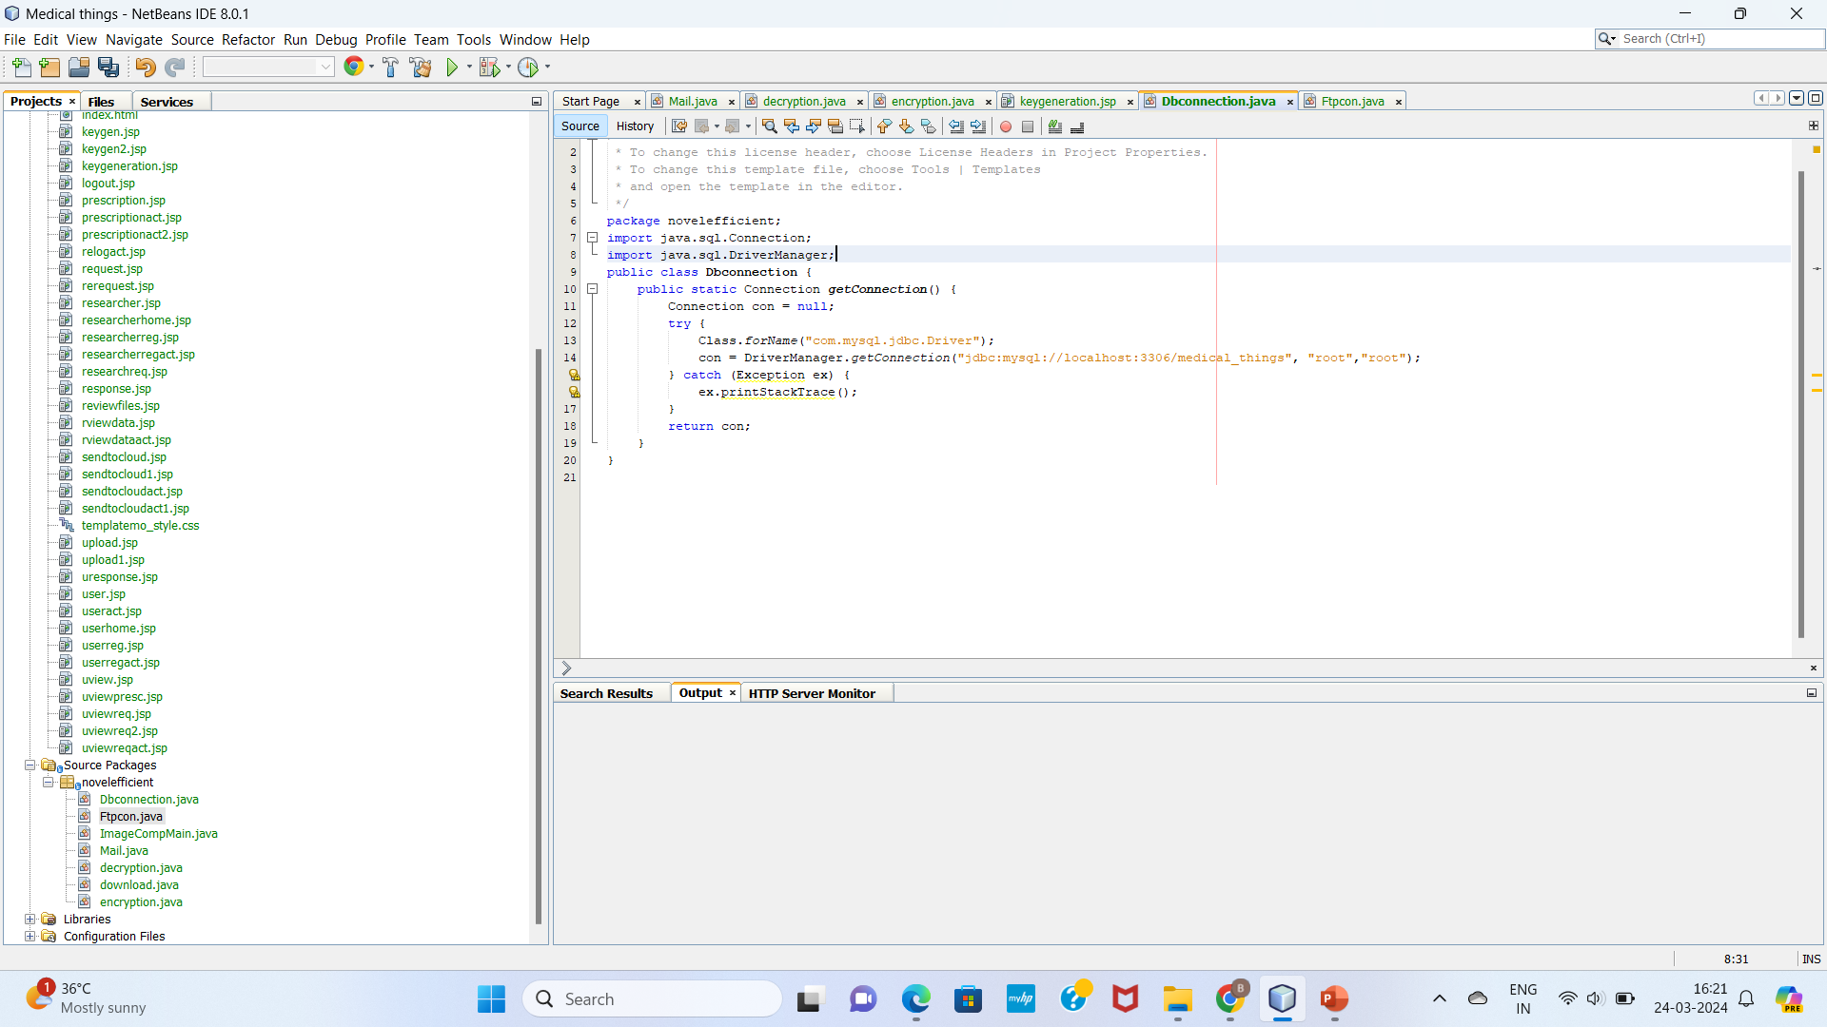
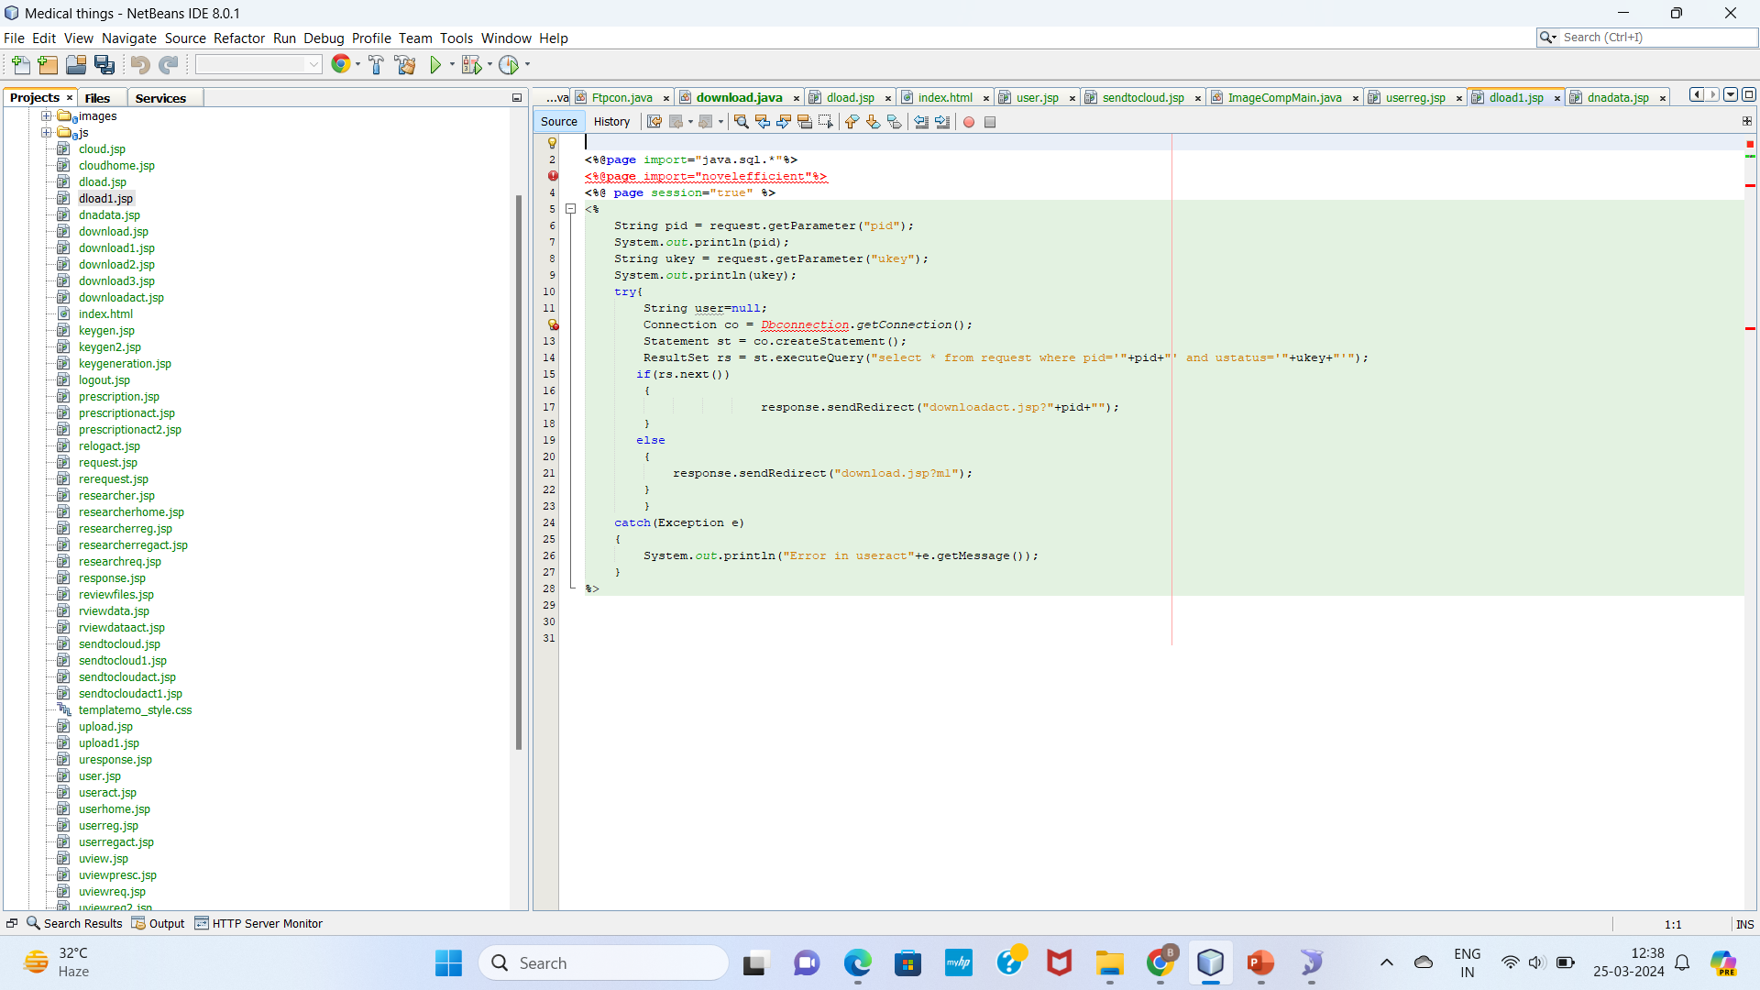
Experiment Screenshots
Database Connection:
Registration:

Slide 10
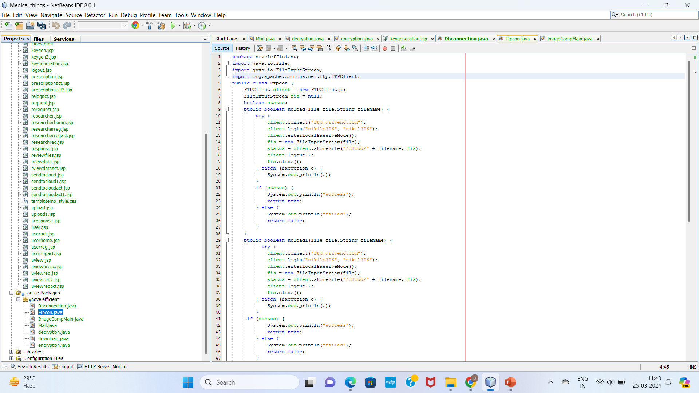
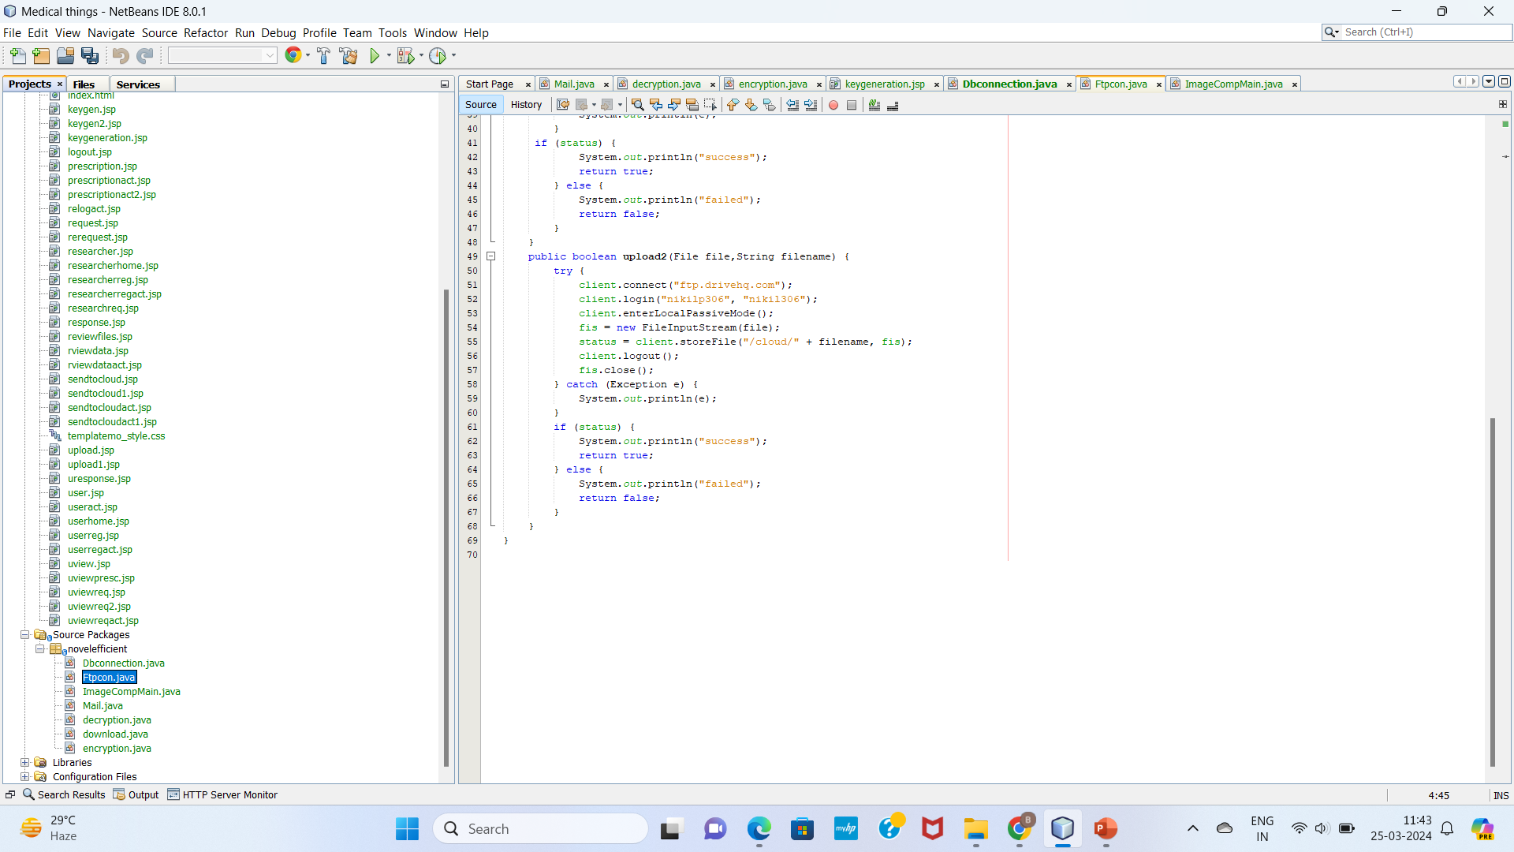
Client Connection to upload file:

Slide 11
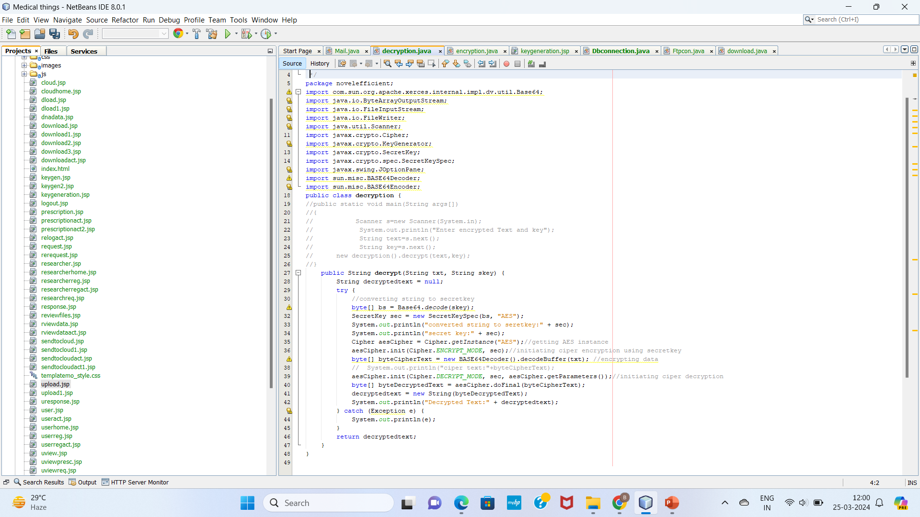
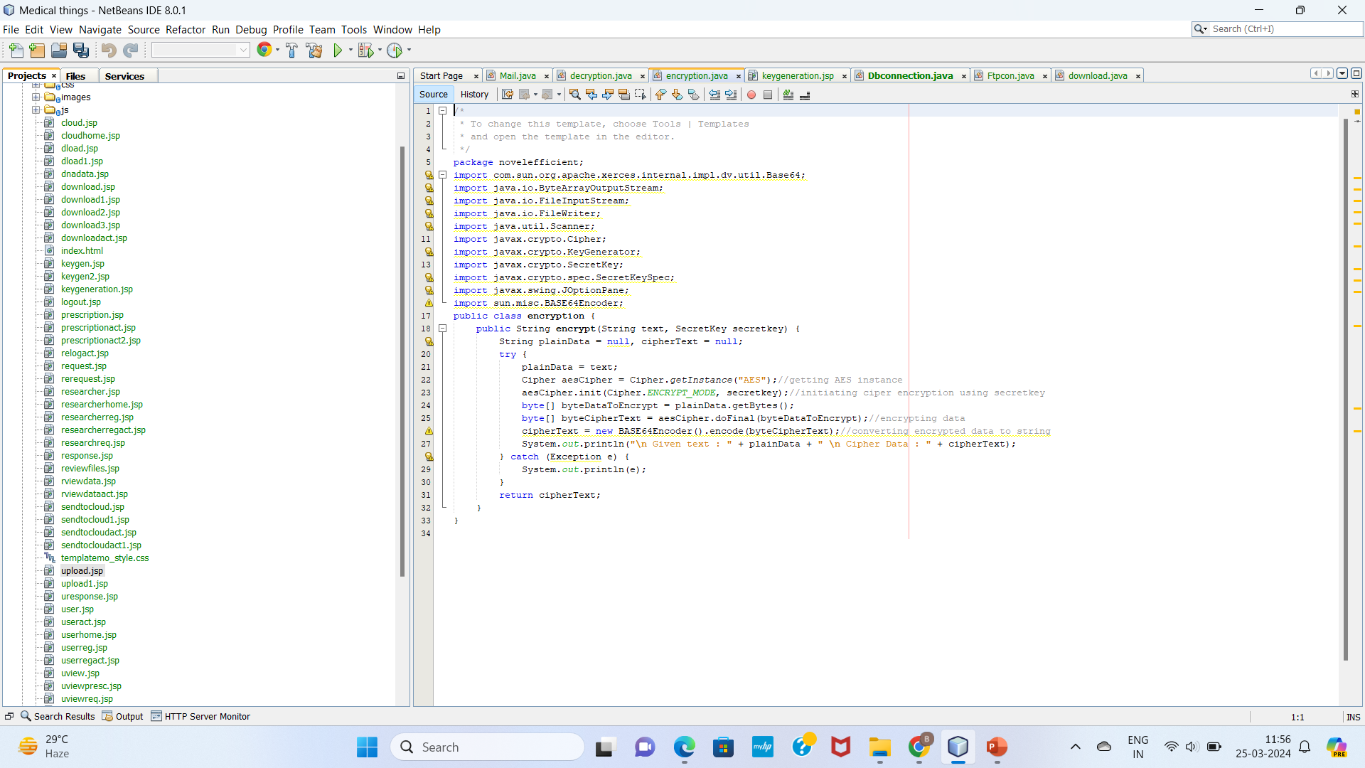
Encryption:
Decryption:

Slide 12
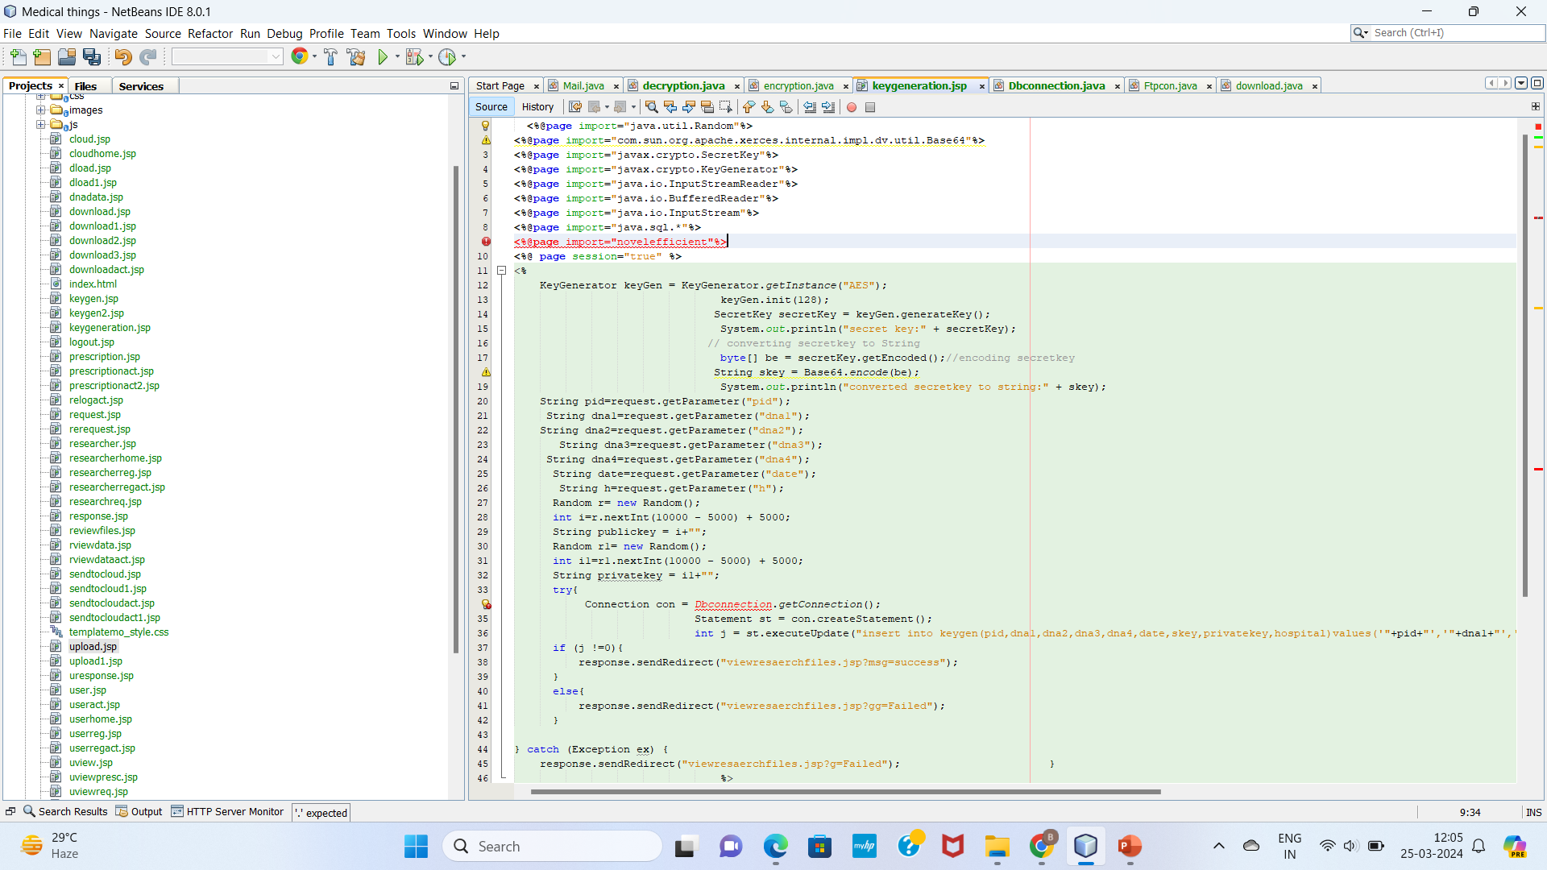
Key Generation:

Slide 13
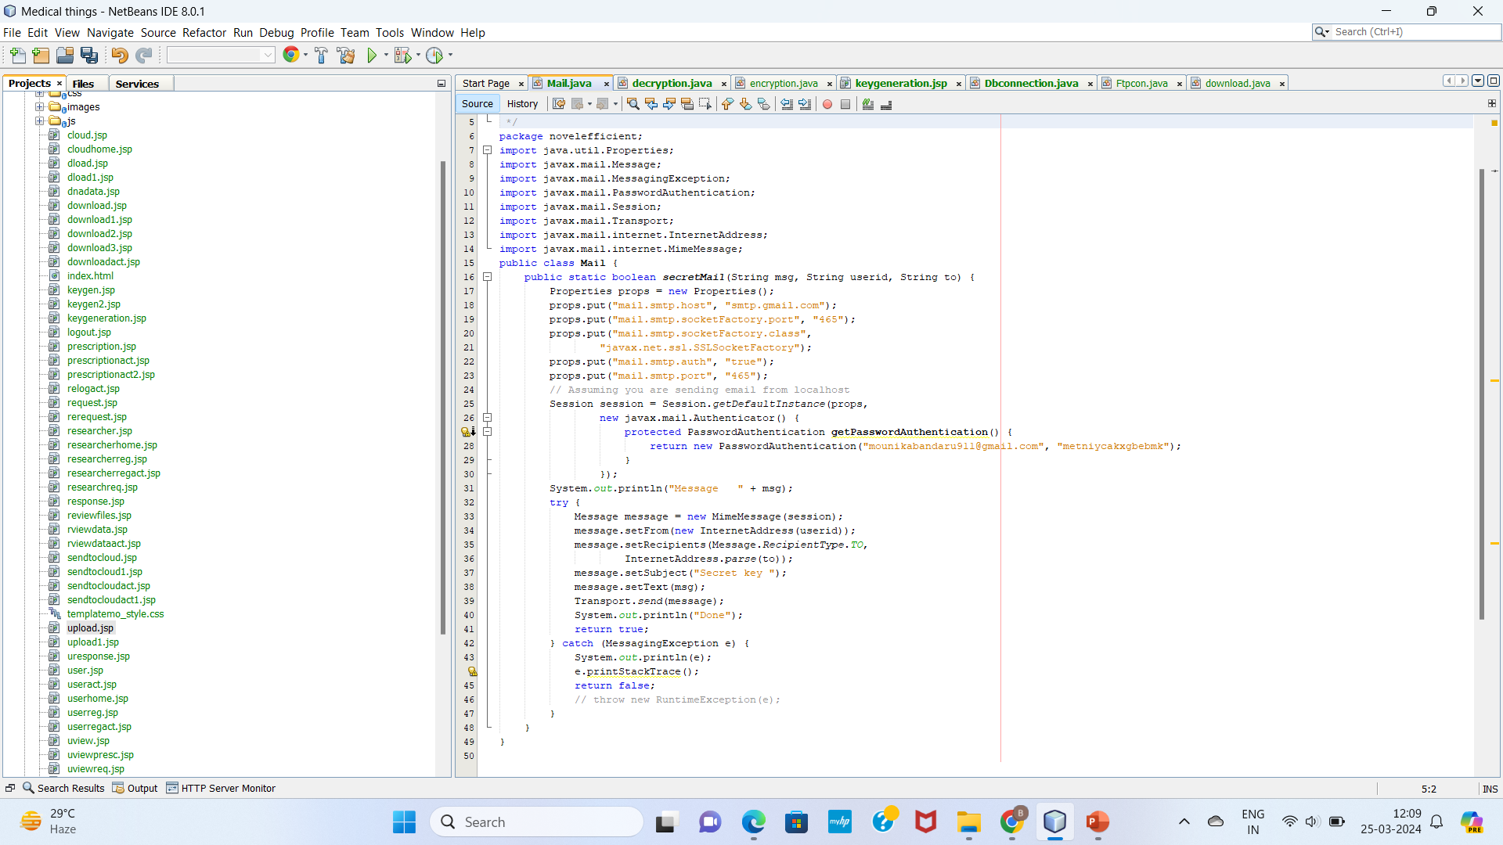
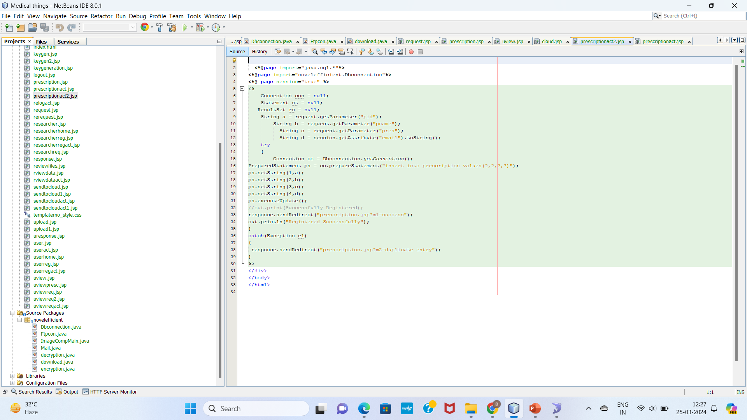
Secret Key:
Prescription:

Slide 14
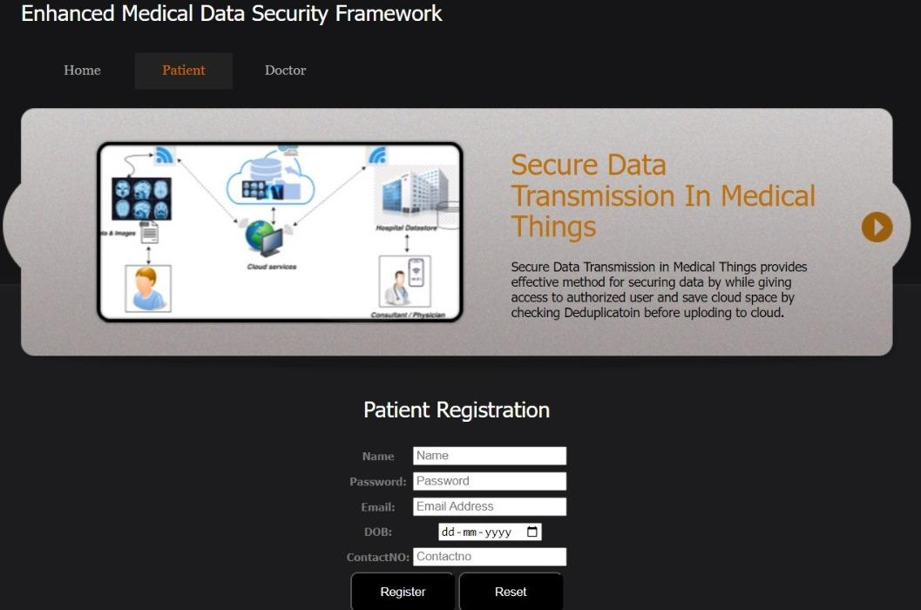
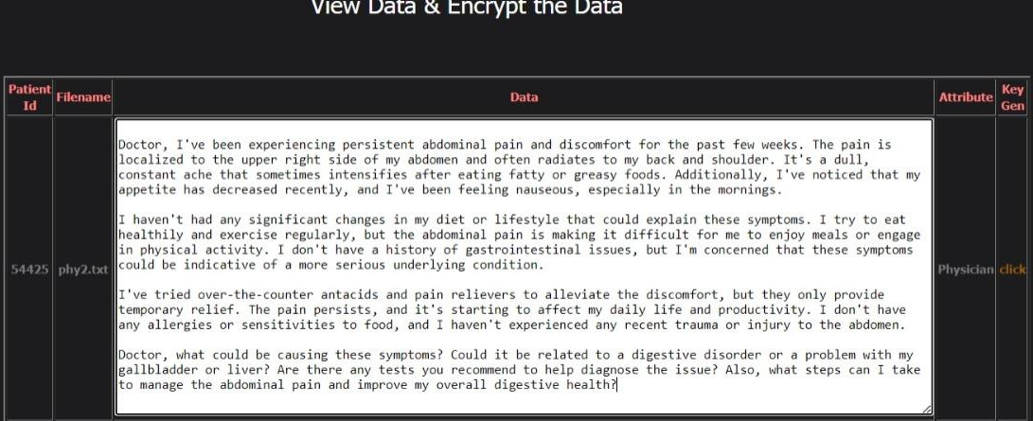
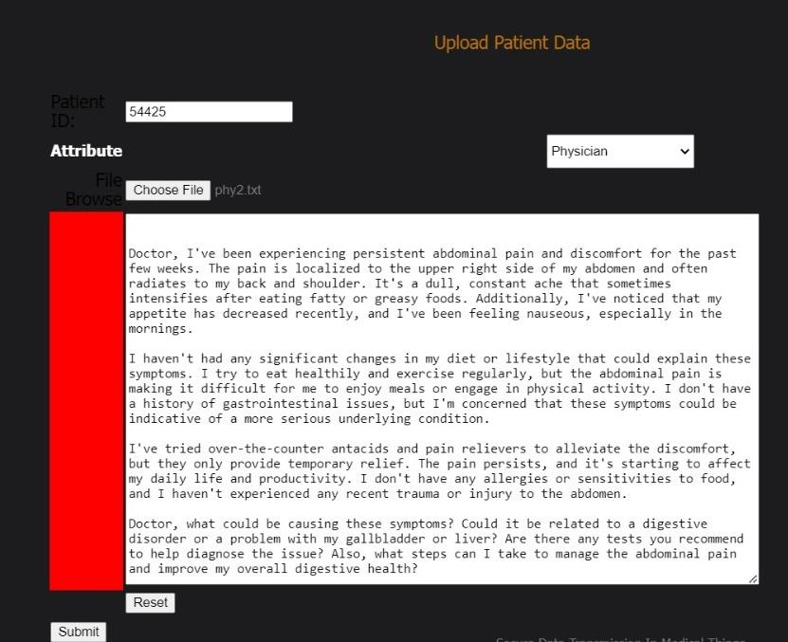
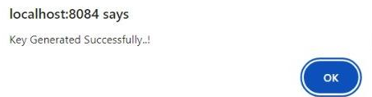
Experiment Results
Registration:
Key Generation:
Uploading the file:

Slide 15
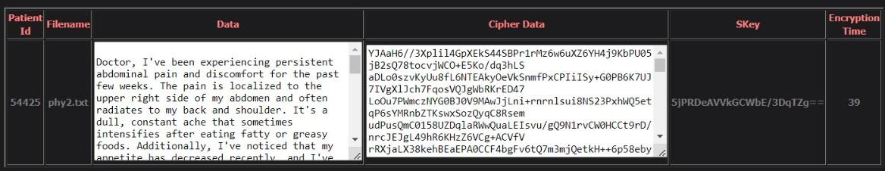
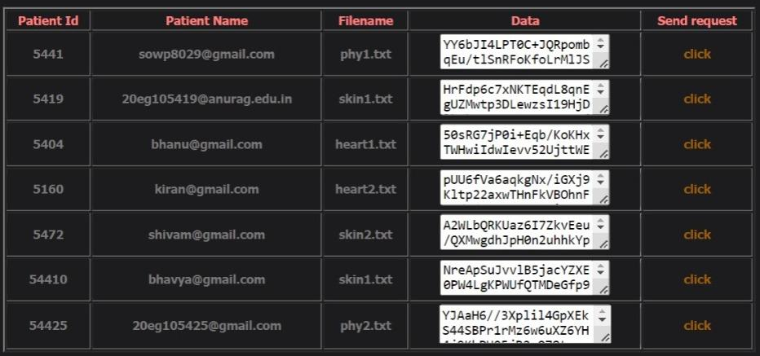


Experiment Results
Encryption:
Request from Respective Doctor:
Patient view Doctor’s request and share the secret key:

Slide 16

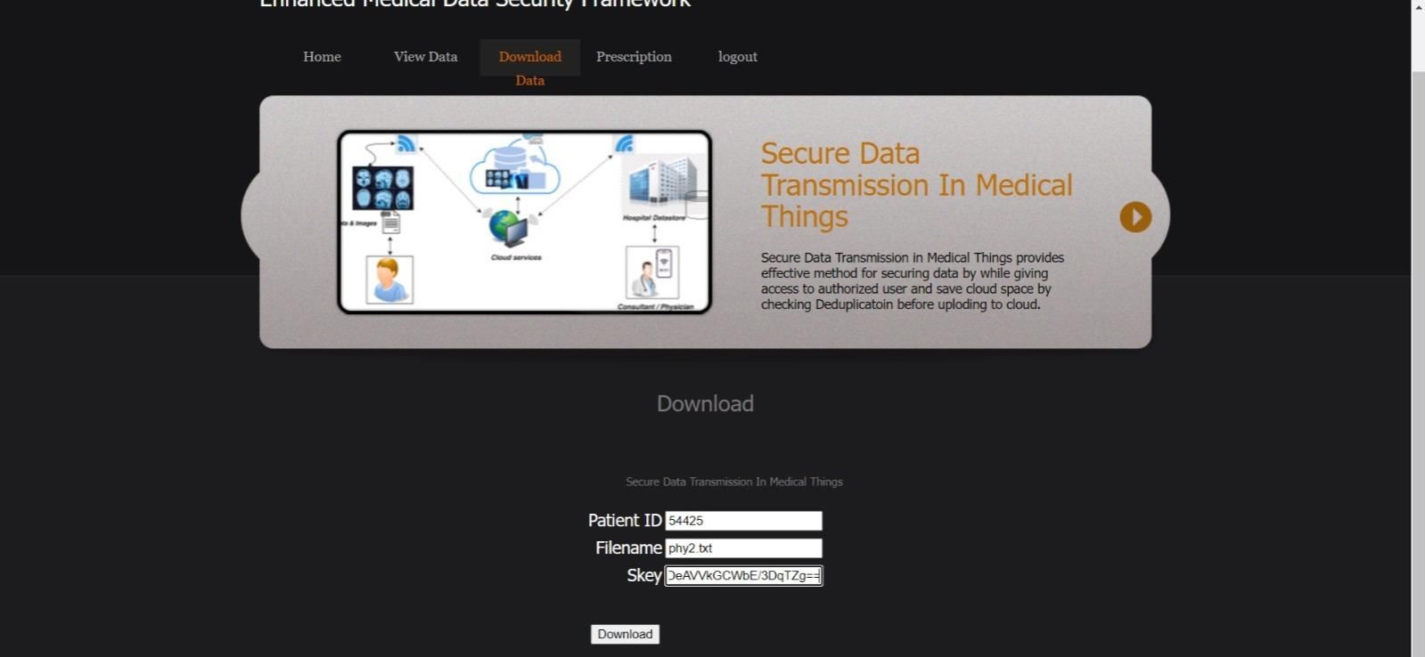
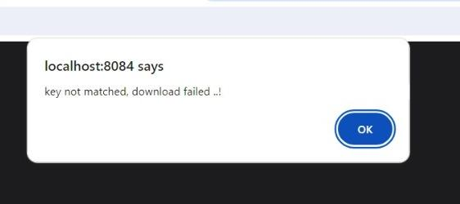
Experiment Results
Secret Key:
Doctor downloads file using the secret key(Decryption):
Secret key not matched then Doctor cannot download the file:

Slide 17
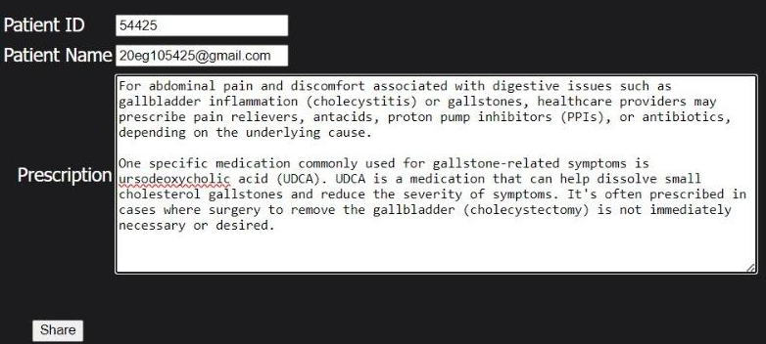
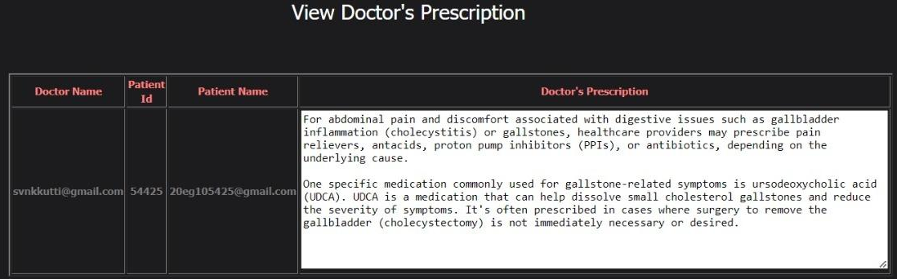
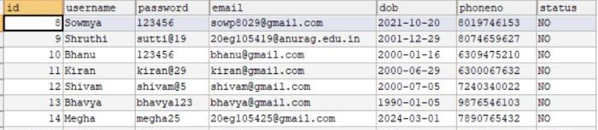
Experiment Results
Doctor shares Prescription:
Patient views the Prescription:
Storing in Database:

Slide 18
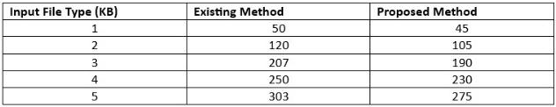
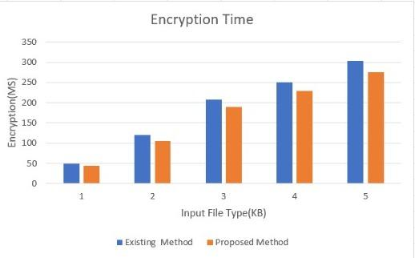
Finding
Effective encryption protocols are vital for safeguarding sensitive data from unauthorized access and breaches. Encryption transforms data into unreadable ciphertext, ensuring confidentiality and compliance with regulations. It fosters trust and enables secure communication, fortifying defenses against cyber threats.

Slide 19
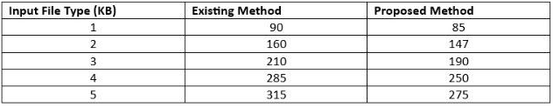
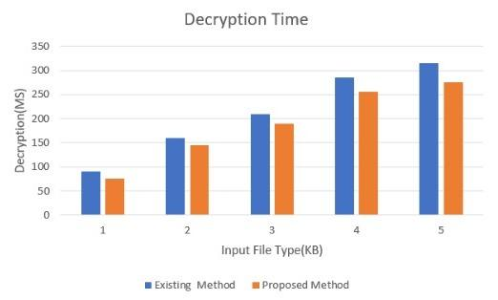
Decryption is essential for accessing encrypted data securely, ensuring data integrity and confidentiality are maintained while enabling authorized users to retrieve and utilize sensitive information.

Slide 20
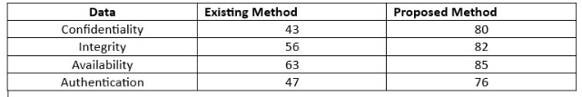
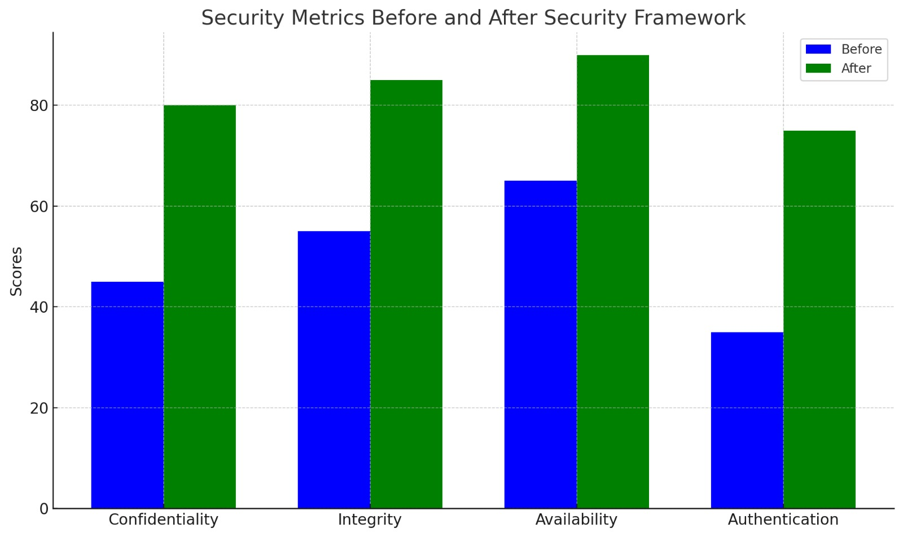
The effectiveness of data encryption measures in preserving confidentiality, integrity, availability, authentication, ensuring that sensitive information remains inaccessible to unauthorized entities.

Slide 21
Justification
1.The parameters improved by proposed method are:
Data Security
Access Control
Key Management
2.We have used a three attributes to improve the framework working process:
Encryption: EAES=f(s,k)
Where, EAES: Efficiency of AES encryption.
s: Size of the input plaintext data.
k: Length of the AES encryption key.
Decryption: DAES=f(s,k)
Where, DAES: Efficiency of AES decryption.
s: Size of the encrypted ciphertext data.
k: Length of the AES decryption key.

Slide 22
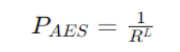
Key Generation:
Where, PAES: Probability of AES key generation success.
L: Length of the AES secret key.
R: Range of possible values for the generated keys.
3. Our parameters are improved as we used the AES algorithm. The utilization of public and private keys, along with strong password protection, ensures controlled remote access while maintaining data confidentiality.
By enhancing security measures and protecting patient data, the ultimate goal is to improve patient care, elevate medical standards, and ensures the integrity of healthcare services in the digital age.

Slide 23
Thank You

